Slide 1
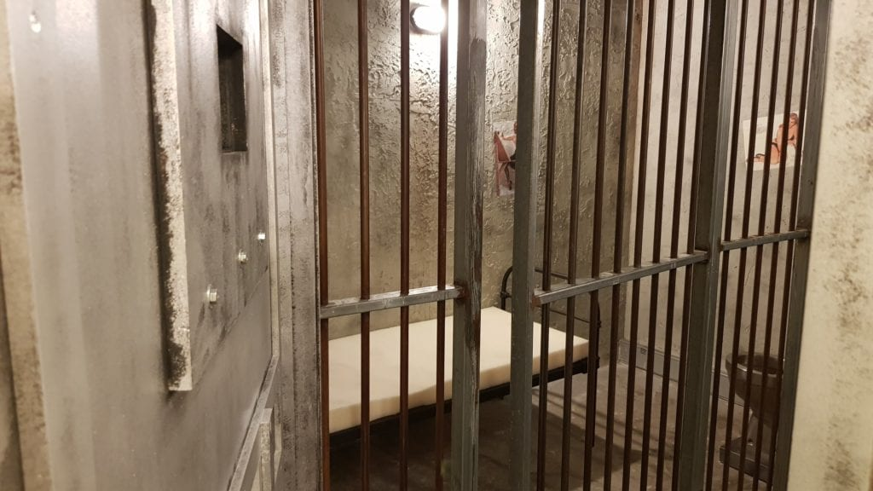

www.foxinaboxgames.com/bowral/
ESCAPE ROOMS FOR CORPORATE AND TEAM BUILDING EVENTS

Slide 2
FOX IN A BOX
Host your next event at Fox In A Box, Bowral’s only escape rooms. Originating in Sweden, Fox in a Box is well established with 24 locations globally, leaving us equipped to provide the best possible experience for your group. Fox in a Box undertook the game design and production for the world’s first Red Bull Mind Games World Championships; they designed the escape room for James Corden’s Late Show and built the BMW escape room in Munich to develop skills and foster bonding for BMW employees. The Fox in a Box Bowral location boasts 4 escape rooms and a comfortable reception area which can be exclusively hired for your corporate and team building requirements. Catering is also an option.
1. The Escape Room
Escape rooms are an immersive experience where your group will have to work together to solve a series of interactive puzzles, clues and scenarios to achieve your final goal - whether it be escaping a life sentence in prison, saving the world from a nuclear explosion, escaping the clutches of a serial killer or possibly staging the ultimate bank heist. All within 60 minutes!
2. The Concept
During the game, players will be pushed to challenge themselves to think outside the box, express innovative ideas and work together as a team to solve challenges. Forget the everyday team & office hierarchy, collaboration is the key to escape where you will be immersed into a unique story and feel like an action movie star!
3. The Difference
We are the only Escape Room company in the Southern Highlands, with dedicated Game Masters and a centralized control room. Each escape room has up to 8 cameras, microphones and speakers so our Game Masters will be watching and guiding you should you need support. With prior arrangements members of HR departments can sit and watch their team in action

Slide 3
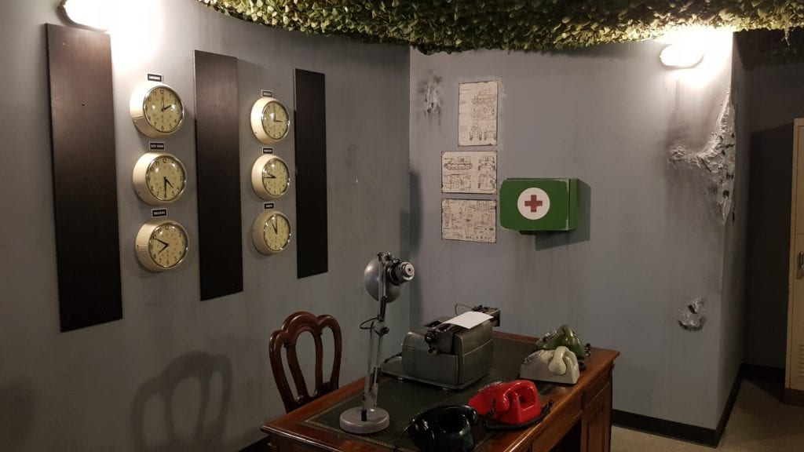




4. Skills Required
CREATIVITY
Turn imaginative ideas in to reality, step out of your comfort zone & challenge everyday thinking.
TEAMWORK
Teamwork will be essential to complete your mission. Join forces and embrace each player’s individual skills to progress and hopefully succeed.
CRITICAL THINKING
Conceptualizing and applying ideas to create logical connections in order to reach your final objective.
FUN
An immersive and unique team building venture that will not be forgotten.
5. Team Benefits
Share an immersive and unique experience
Facilitate team collaboration in an alternative environment
Strengthen cohesion, solidarity and team spirit
Explore and discover each others' talents
Elevate open communication and listening skills
Improve collective and individual decision making
Engage ingenuity while working under pressure

Slide 4
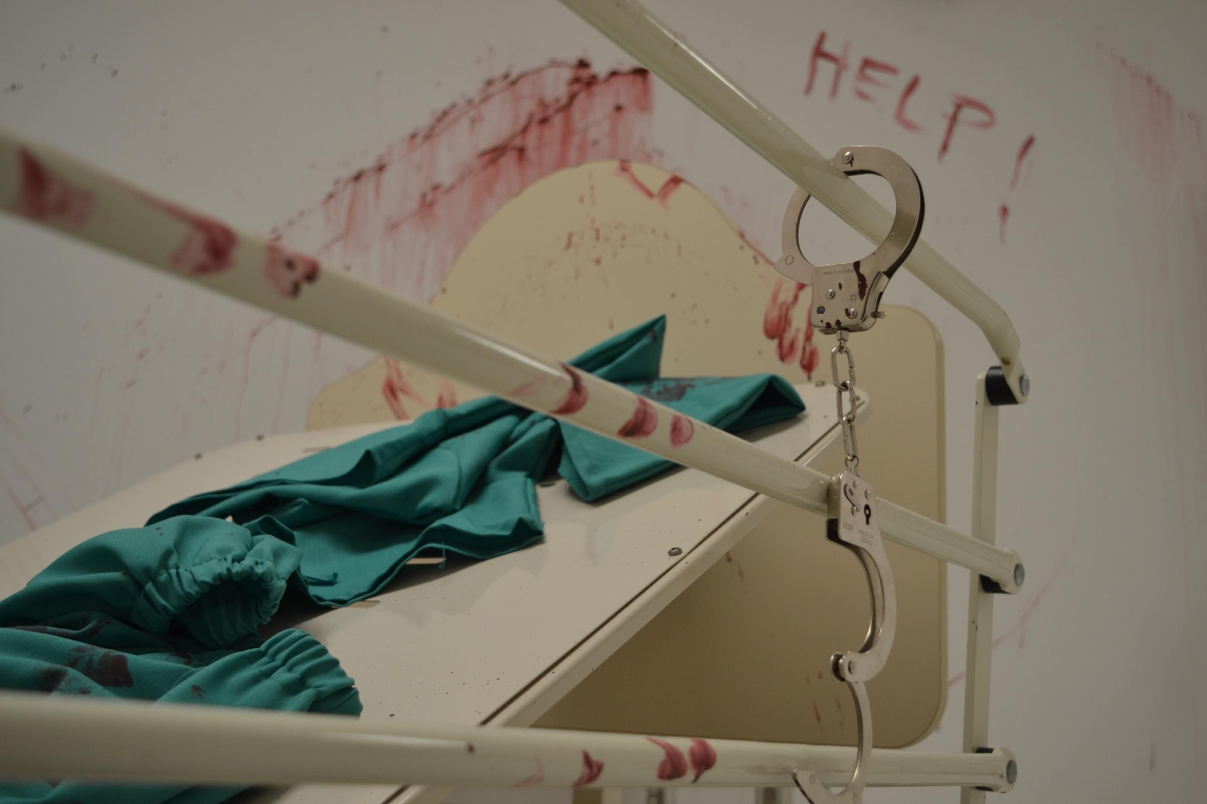
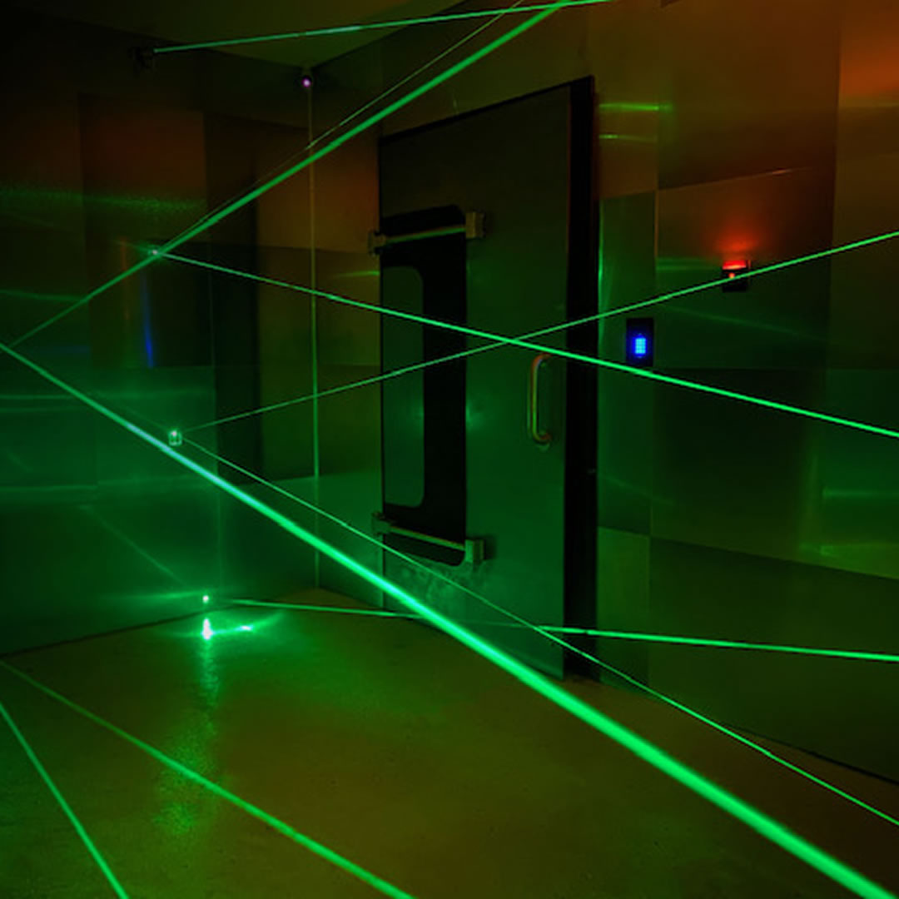
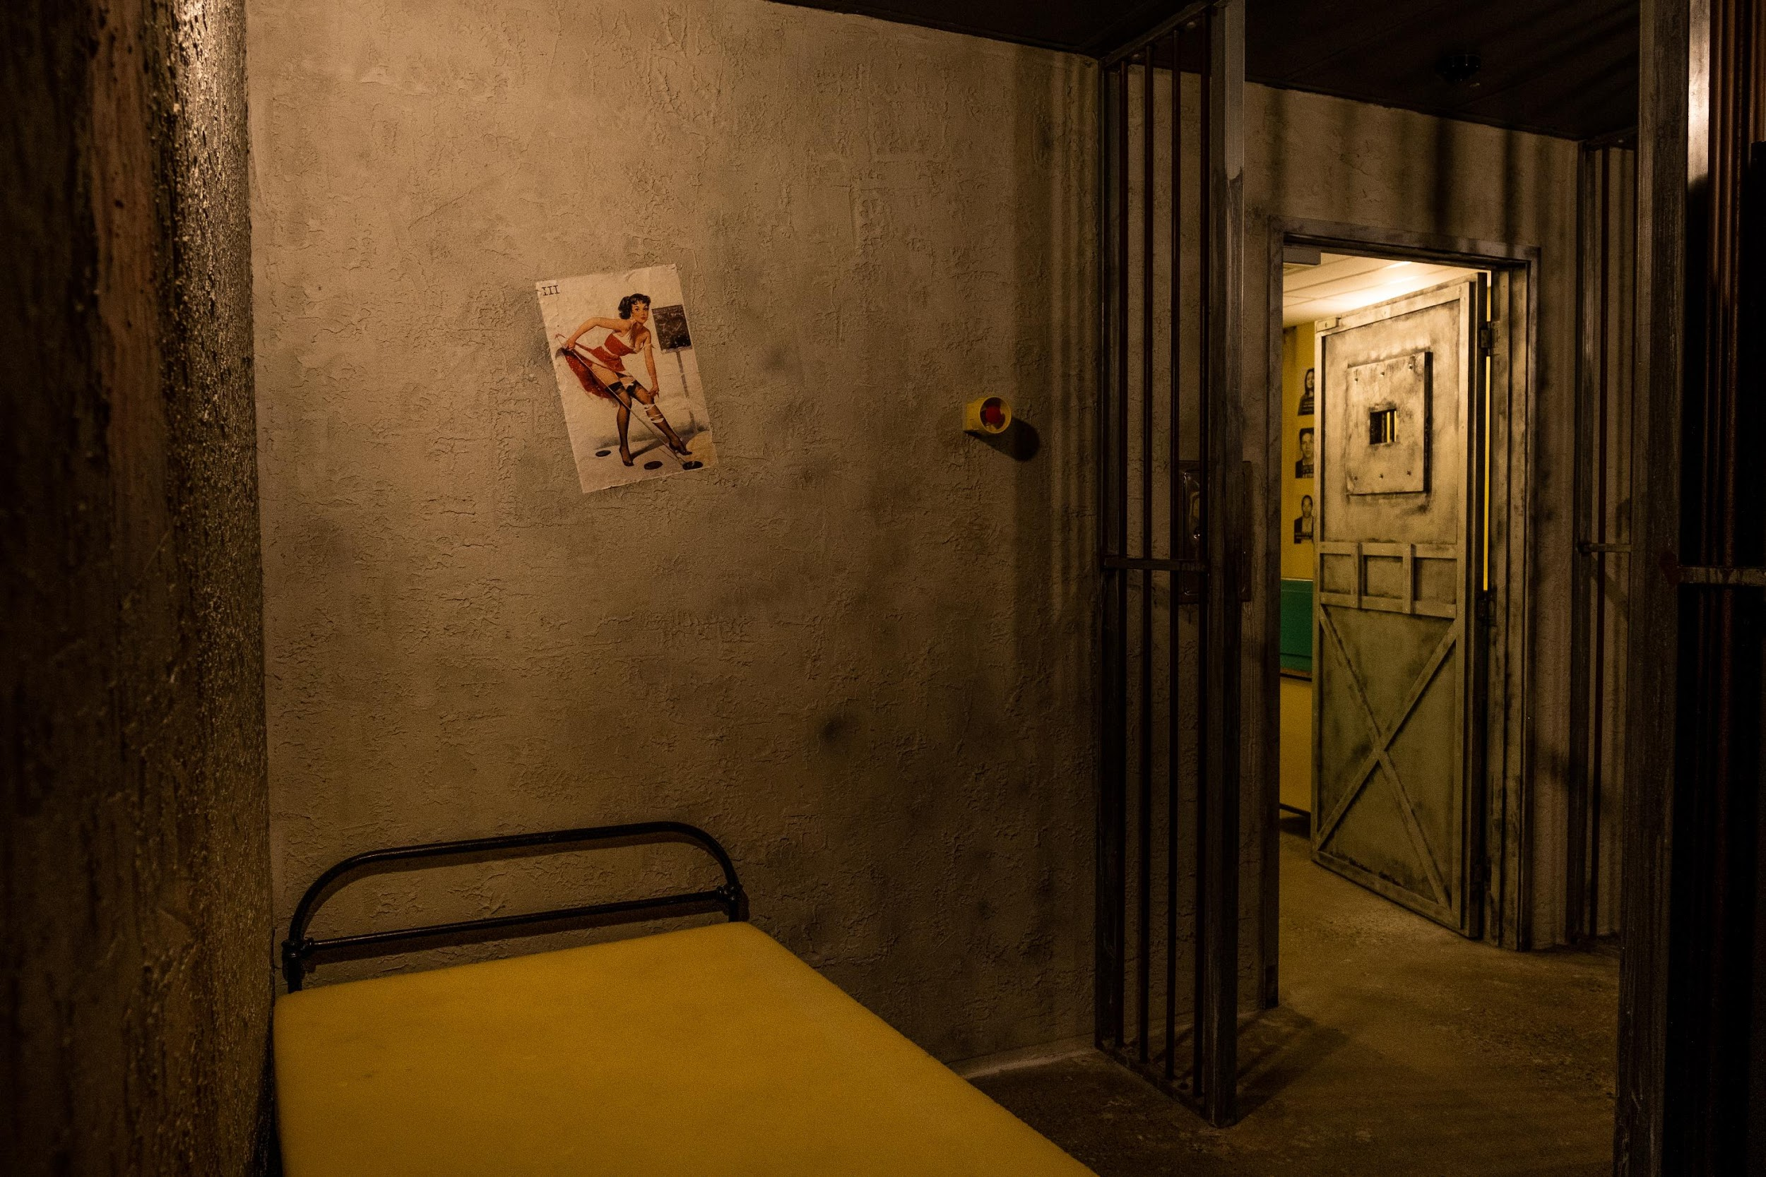
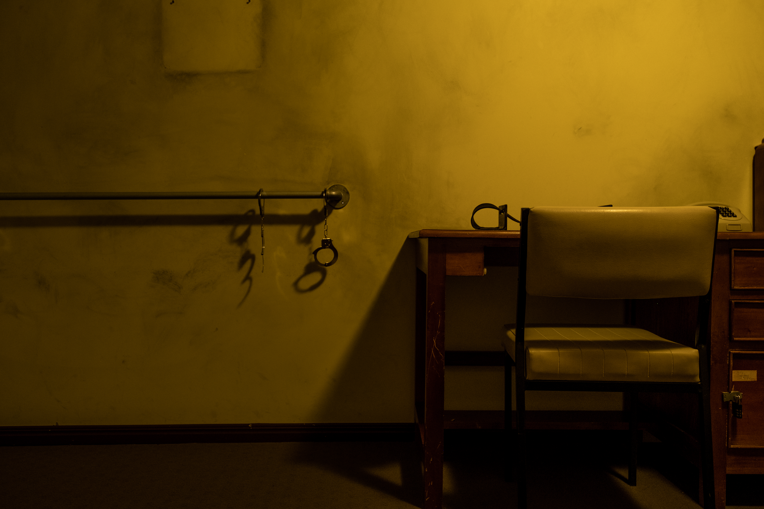
OUR ROOMS
Mastermind Heist
Life Sentence
In darkness carrying torches you break into the prestigious United Bank. Can you hack the computer and security systems to break into the vault to get to the diamonds before anyone realizes what is going on?
You are sentenced to life in a maximum-security prison. With all appeal requests denied, your only path to freedom is to escape.
Bunker
Zodiac Killer
Early 80’s, the Cold War. A nuclear launch sequence has been initiated from the bunker. Your team of special agents are sent to stop the launch at any cost.
Captured by a serial killer, tied up & left in his lair, escape is your only chance. Has the real Zodiac Killer returned from the 1970’s or is this the work of a copycat?

Slide 5
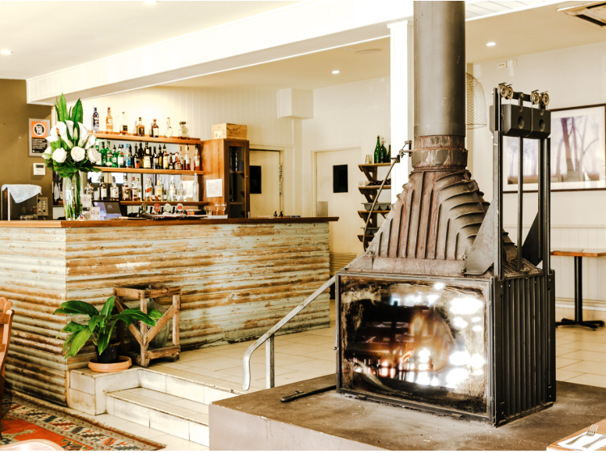
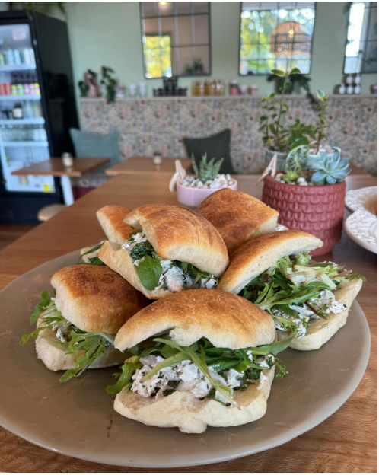
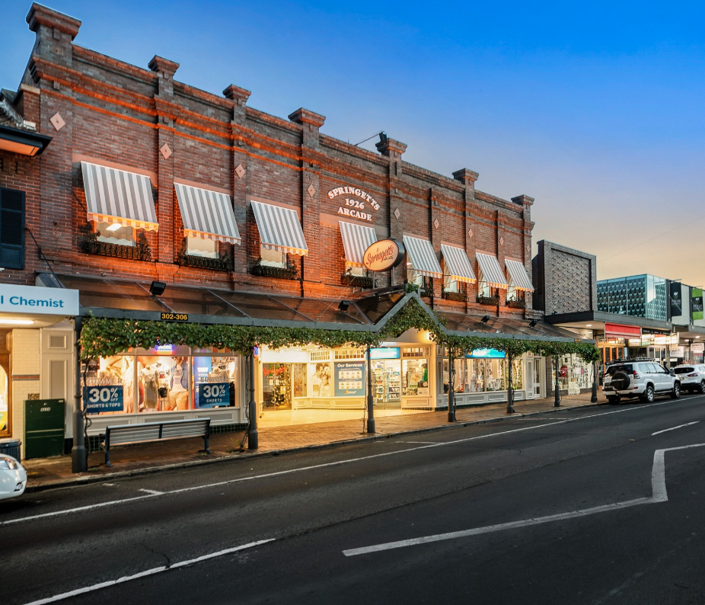
FOOD & DRINK
Fox in a Box Bowral is exceptionally well set up to meet the needs of corporate and team building events. We boast a comfortable reception area that is large enough to seat 24 people through a combination of high bar tables and stools and comfy benches. This, along with our flexible catering options, provides the perfect opportunity to reflect on your experience whilst enjoying a range of refreshments.
Alternatively, our central location in Bowral means our escape room is just a short stroll from popular pubs, cafés, and everything else your team needs for the perfect day out.
THE ROYAL HOTEL - 600m walk
THE RABBIT HOLE – 50m walk
BOWRAL MAIN STREET – 700m walk

Slide 6
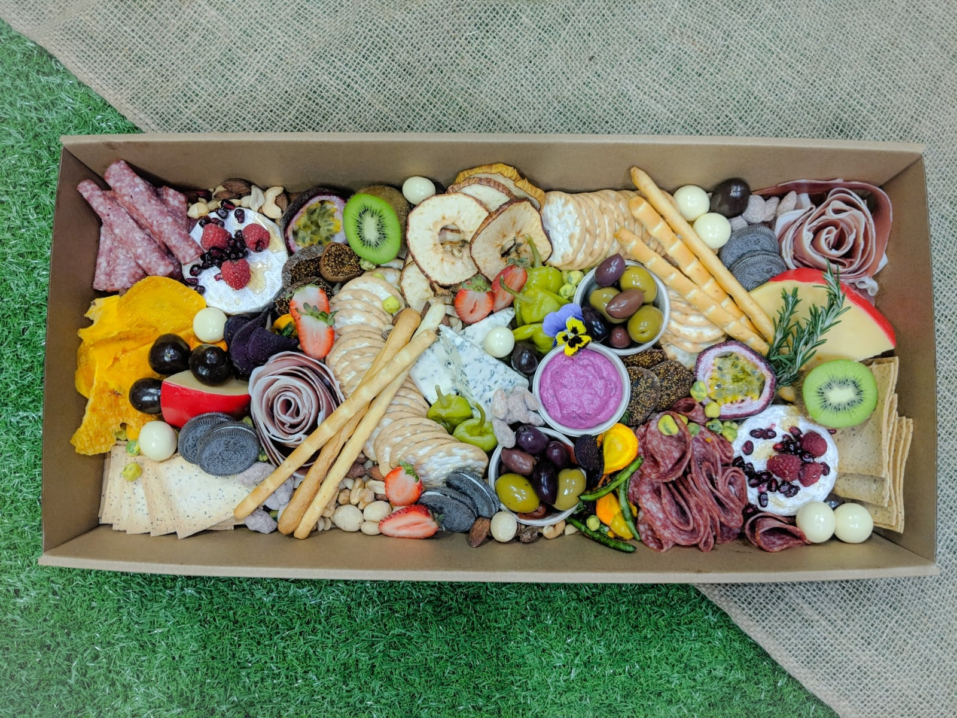
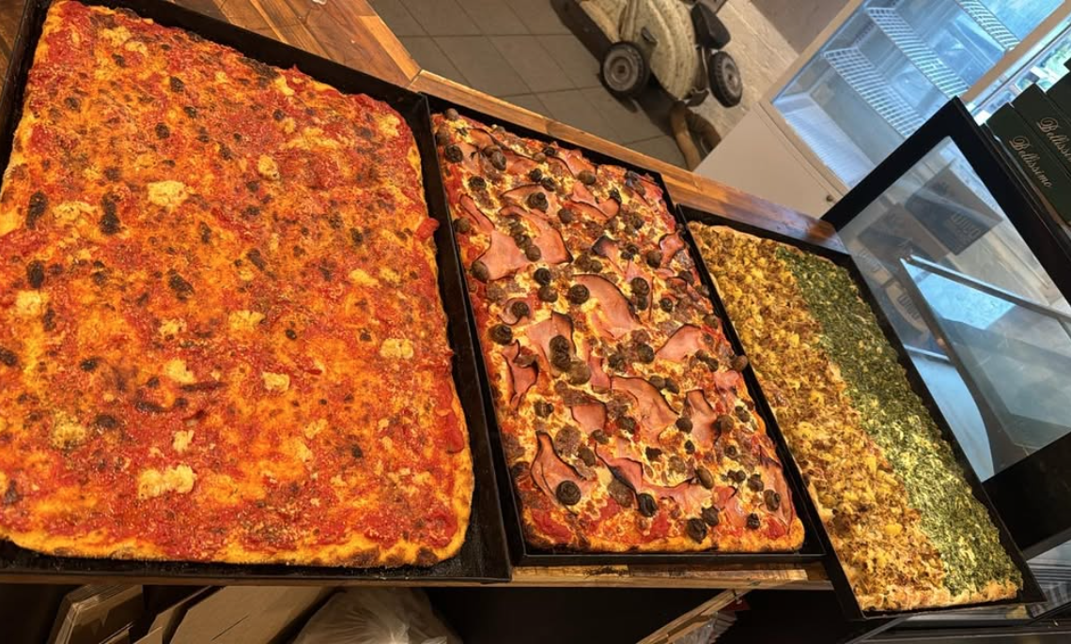
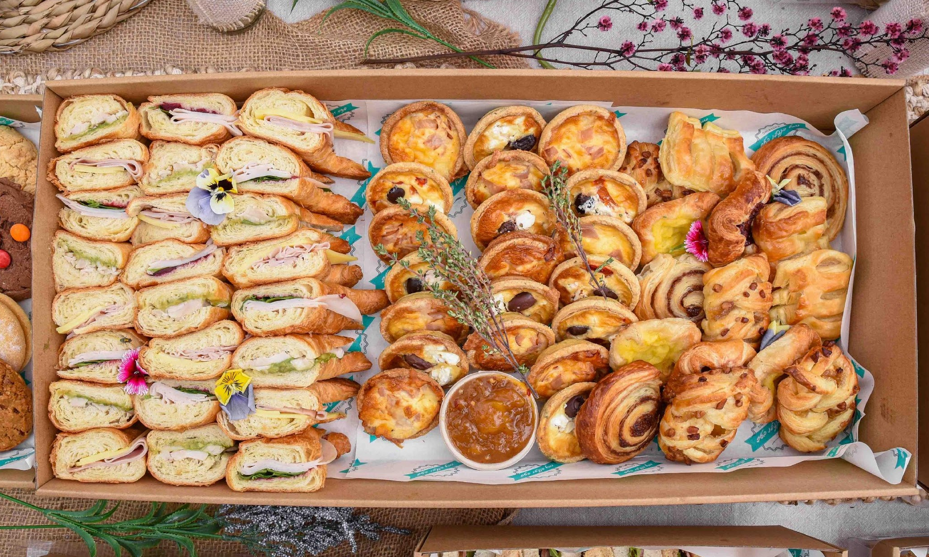
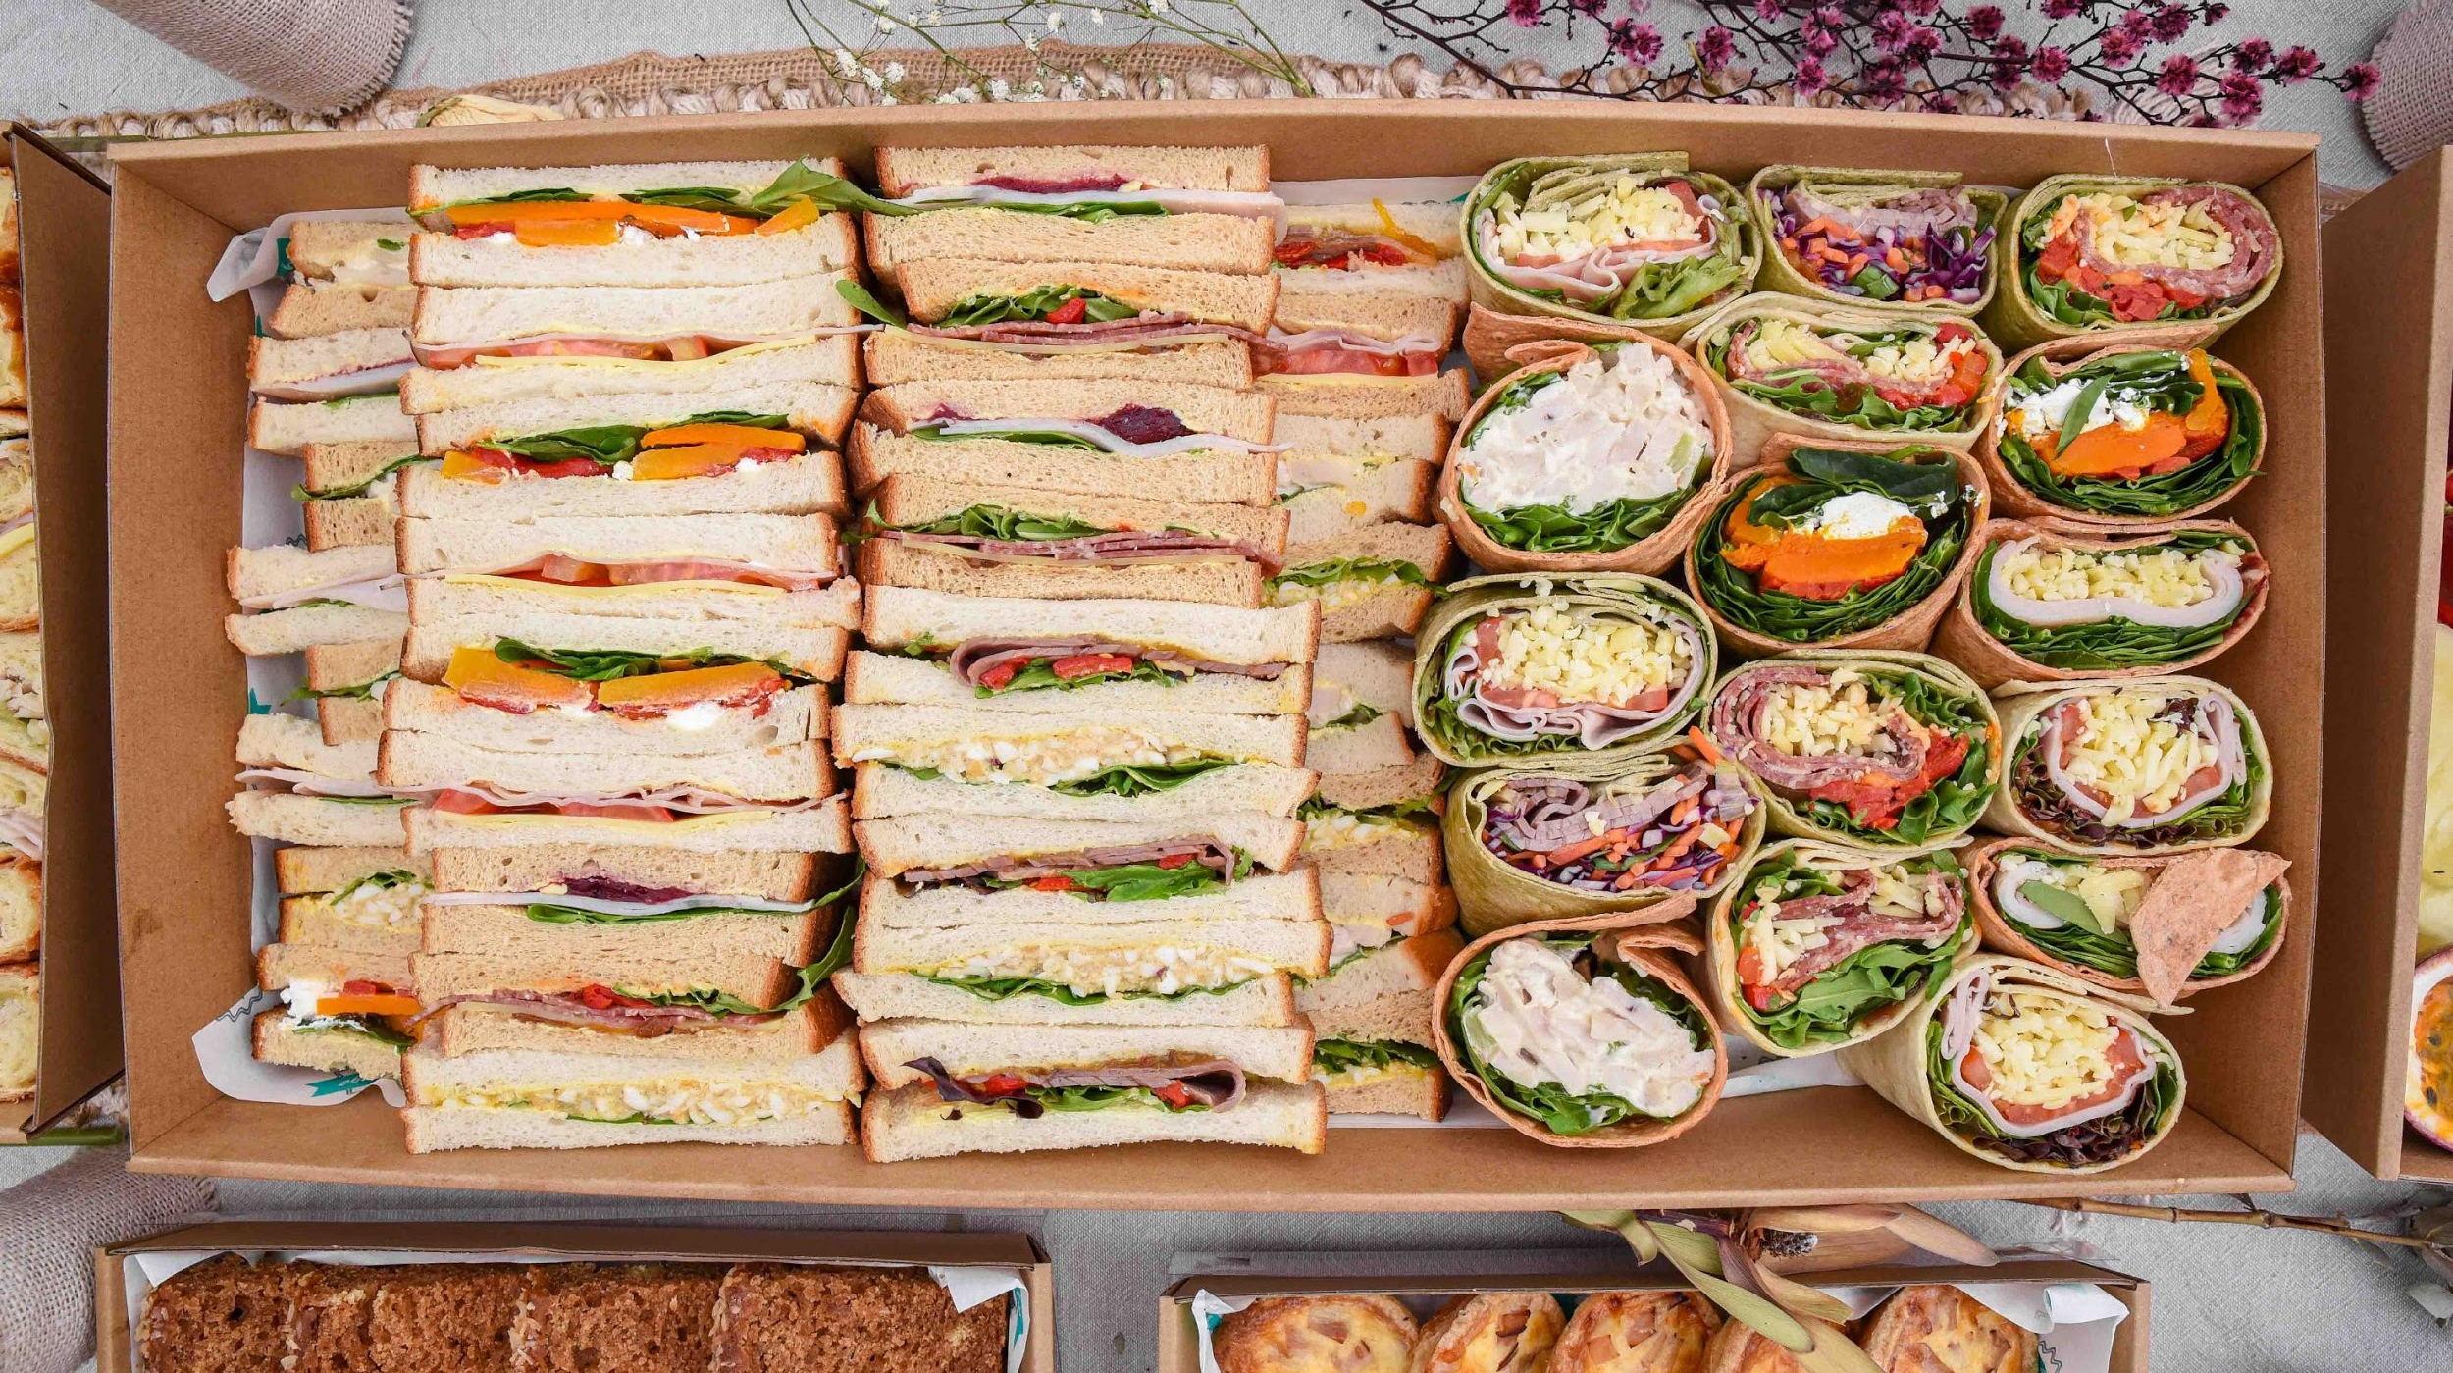
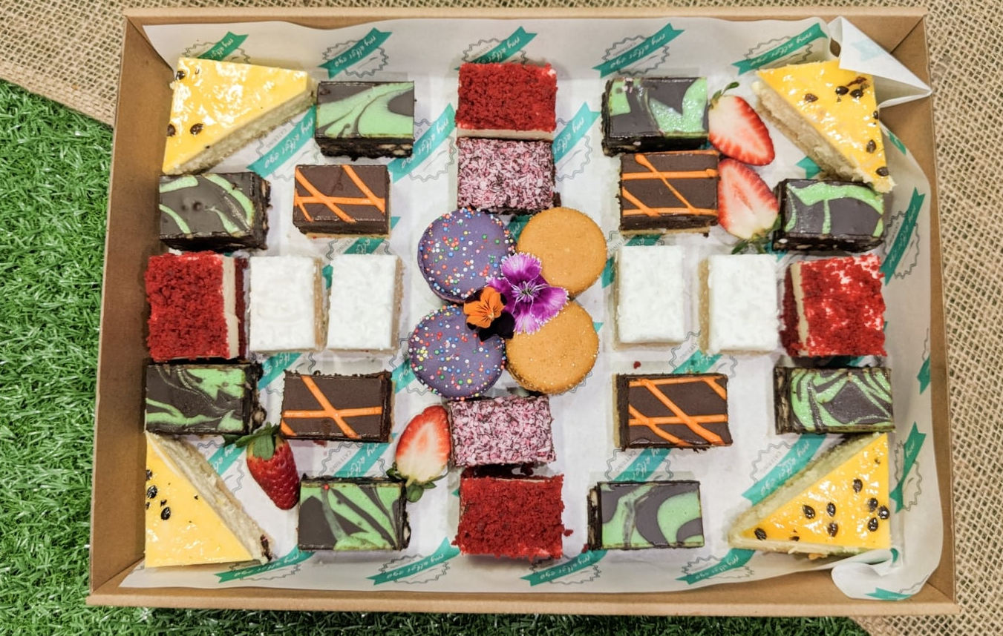


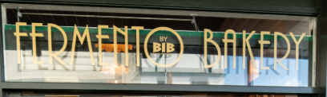
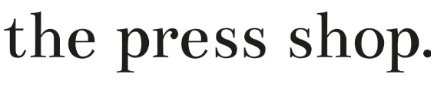
FOOD & DRINK
Catering options are available Monday-Friday (not available after 4pm on Friday), for groups of 18 or more people and if you are playing 2 games or more. Vegan options & fruit platters are also available upon request. Contents may change slightly depending on your choices made and the number of players.
Signature Box - selection of locally sourced fresh produce, cheeses, crackers, dips and cured meats.
4-6ppl - $130;
10-14ppl - $240
Pizza by the meter – Perfect for an easy lunch and a hungry bunch!
Ideal for 8-10ppl - $105
Brunch Box - Brunching with friends? This is the box for you! A section of croissants, Danishes and petite quiches.
Ideal for 10-12ppl - $155
Sandwich box - A box to feed a hungry bunch. Gourmet wraps and ribbon sandwiches. Ideal for 10-12ppl - $120
Sweet Tooth - A box full of bite sized treats for you to enjoy.
For 8-10ppl - $105

Slide 7
ROOM PRICING
General Information. All of our Corporate packages are available from Monday to Saturday, with groups over 18 players available Monday – Friday only. We have four Escape Rooms, and a maximum of six people can play per room giving a total capacity of 24 players all playing at the same time. If your group has 19 players or more, you will have exclusive use of our venue for your session. This allows you to choose which games you want to play on arrival and how many play in each room (up to a maximum of 6 per room). For groups larger than 24, we can run two rounds of games across two sessions.
Number of Players
12-24 players
19 or more - (Mon-Fri only)
Cost for 1 Game (1 hour plus)
No catering is available for this option
$40 per player
Exclusive venue use
Cost for 2 Games (2.5 hours plus)
Catering available
$75 per player
Exclusive venue use
Game Times and Arrival. Our Games run from 10am until 10pm, 7 days per week. Actual start times can be found on our website. However, we do require guests to arrive 20 minutes prior to your start time in order to allow players to use our facilities, sign waivers, undertake a game briefing and to relax.
Game Length. Each game runs for 1 hour, unless your team manages to complete the room earlier. At the end of the game each team's dedicated Games Master will run through a debrief and take photos of the team inside the room. Photos will be sent to the details completed on the players waiver. Allow approximately 10 minutes for debrief and photos.

Slide 8
HOW TO BOOK
Bookings or enquiries can be made over the phone, via email or by completing our online form:
Telephone 04 6075 8969
Email info@foxinabowral.com
Complete our online form
Please provide the following information via email when you are ready to make your booking:
Name for Invoice
Contact Number
Date
Time
Number of players
The rooms you would like to play (4-6 players per room). Groups of 18 or more have exclusive venue use.
If you would like to consider catering - minimum 7 days’ notice required. Only available for 2 or more back-to-back games Monday to Friday (not available after 4pm Friday)
Payments can be made over the phone or via bank transfer.
Within 48 hours of reserving your booking we will require a 20% non-refundable deposit otherwise the reservation will be forfeited.
Final balance is due one week prior to your event.
Fox in a Box Bowral
Unit 17, 63-69 Kirkham Road, Bowral, NSW 2576
Tel: 04 6075 8969
info@foxinaboxbowral.com
https://www.foxinaboxgames.com/bowral

Slide 9
















ESCAPE ROOMS FOR CORPORATE AND TEAM BUILDING EVENTS AT OTHER LOCATIONS

